Slide 1
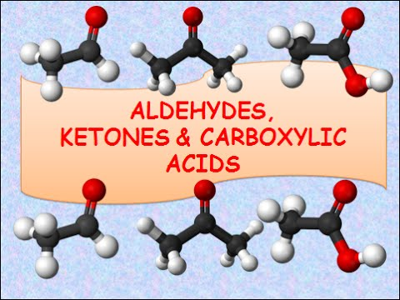

Slide 2
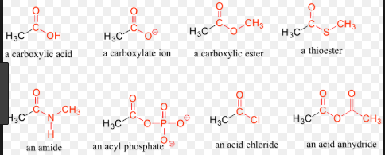
COMPOUNDS CONTAINING CARBONYL GROUP

Slide 3
CARBONYL GROUP IN NATURE

Slide 4
NOMENCLATURE OF ALDEHYDE
COMMON NAME
IUPAC NAME

Slide 5
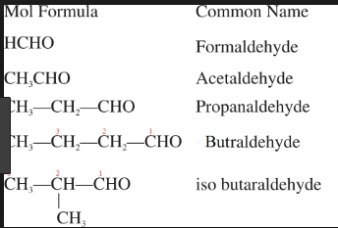
COMMON NAME OF ALDEHYDES

Slide 6
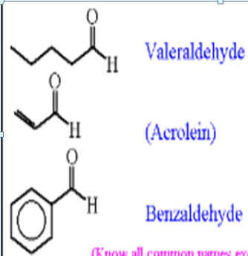

Slide 7
IUPAC NAME OF ALDEHYDES

Slide 9
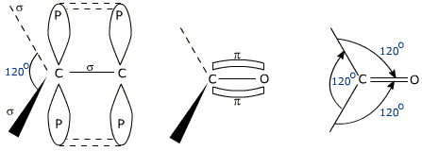
STRUCTURE OF CARBONYL GROUP

Slide 10
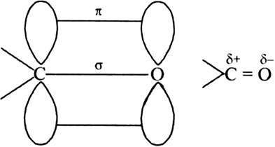
Structure of carbonyl group

Slide 11
PREPARATION OF ALDEHYDES AND KETONE
FROM ALCOHOL

Slide 12
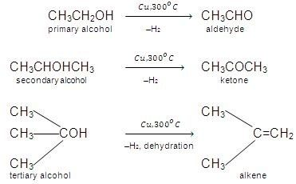
BY DEHYDROGENATION OF ALCOHOL

Slide 13
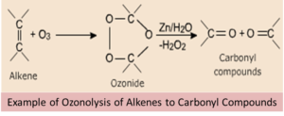
FROM HYDROCARBON
1. OZONOLYSIS

Slide 14
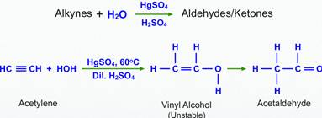
2. HYDRATION OF ALKYNES

Slide 15
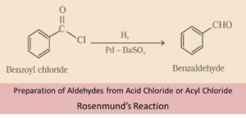
PREPARATION OF ALDEHYDES
1. FROM ACYL CHLORIDE(ACID CHLORIDE)

Slide 16
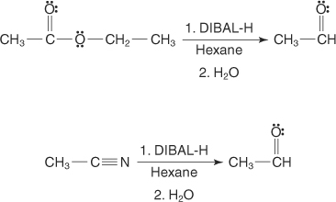
2. FROM NITRILE AND ESTER

Slide 17
3. FROM HYDROCARBON
BY OXIDATION OF METHYLBENZENE
BY SIDE CHAIN CHLORINATION
FOLLOWED BY HYDROLYSIS
c)BY GATTERMAN – KOCH REACTION

Slide 18
a)BY OXIDATION OF METHYLBENZENE
USE OF CHROMIC OXIDE
USE OF CHROMYL CHLORIDE

Slide 19
USE OF CHROMIC OXIDE

Slide 20
USE OF CHROMYL CHLORIDE
CHROMIUM COMPLEX
BENZALDEHYDE

Slide 21
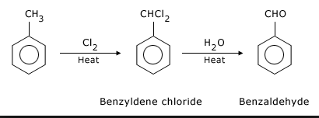
b) BY SIDECHAIN CHLORINATION FOLLOWED BY HYDROLYSIS

Slide 22
c) BY GATTER – KOCH REACTION

Slide 25
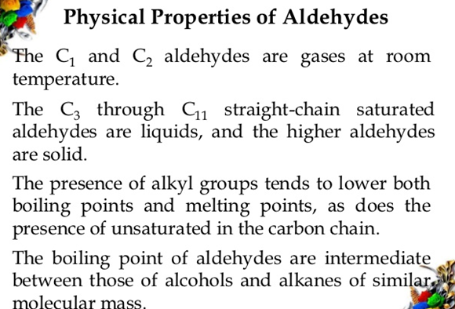

Slide 26
